Slide 1
Depth-dependent Binovisualfields
Domain knowledge / Programming
Package submission to CRAN

Slide 2
A bit about myself
Zero programming skills before PhD
Self-taught during my PhD
Passionate working on projects at the intersection of health science and technology

Slide 3
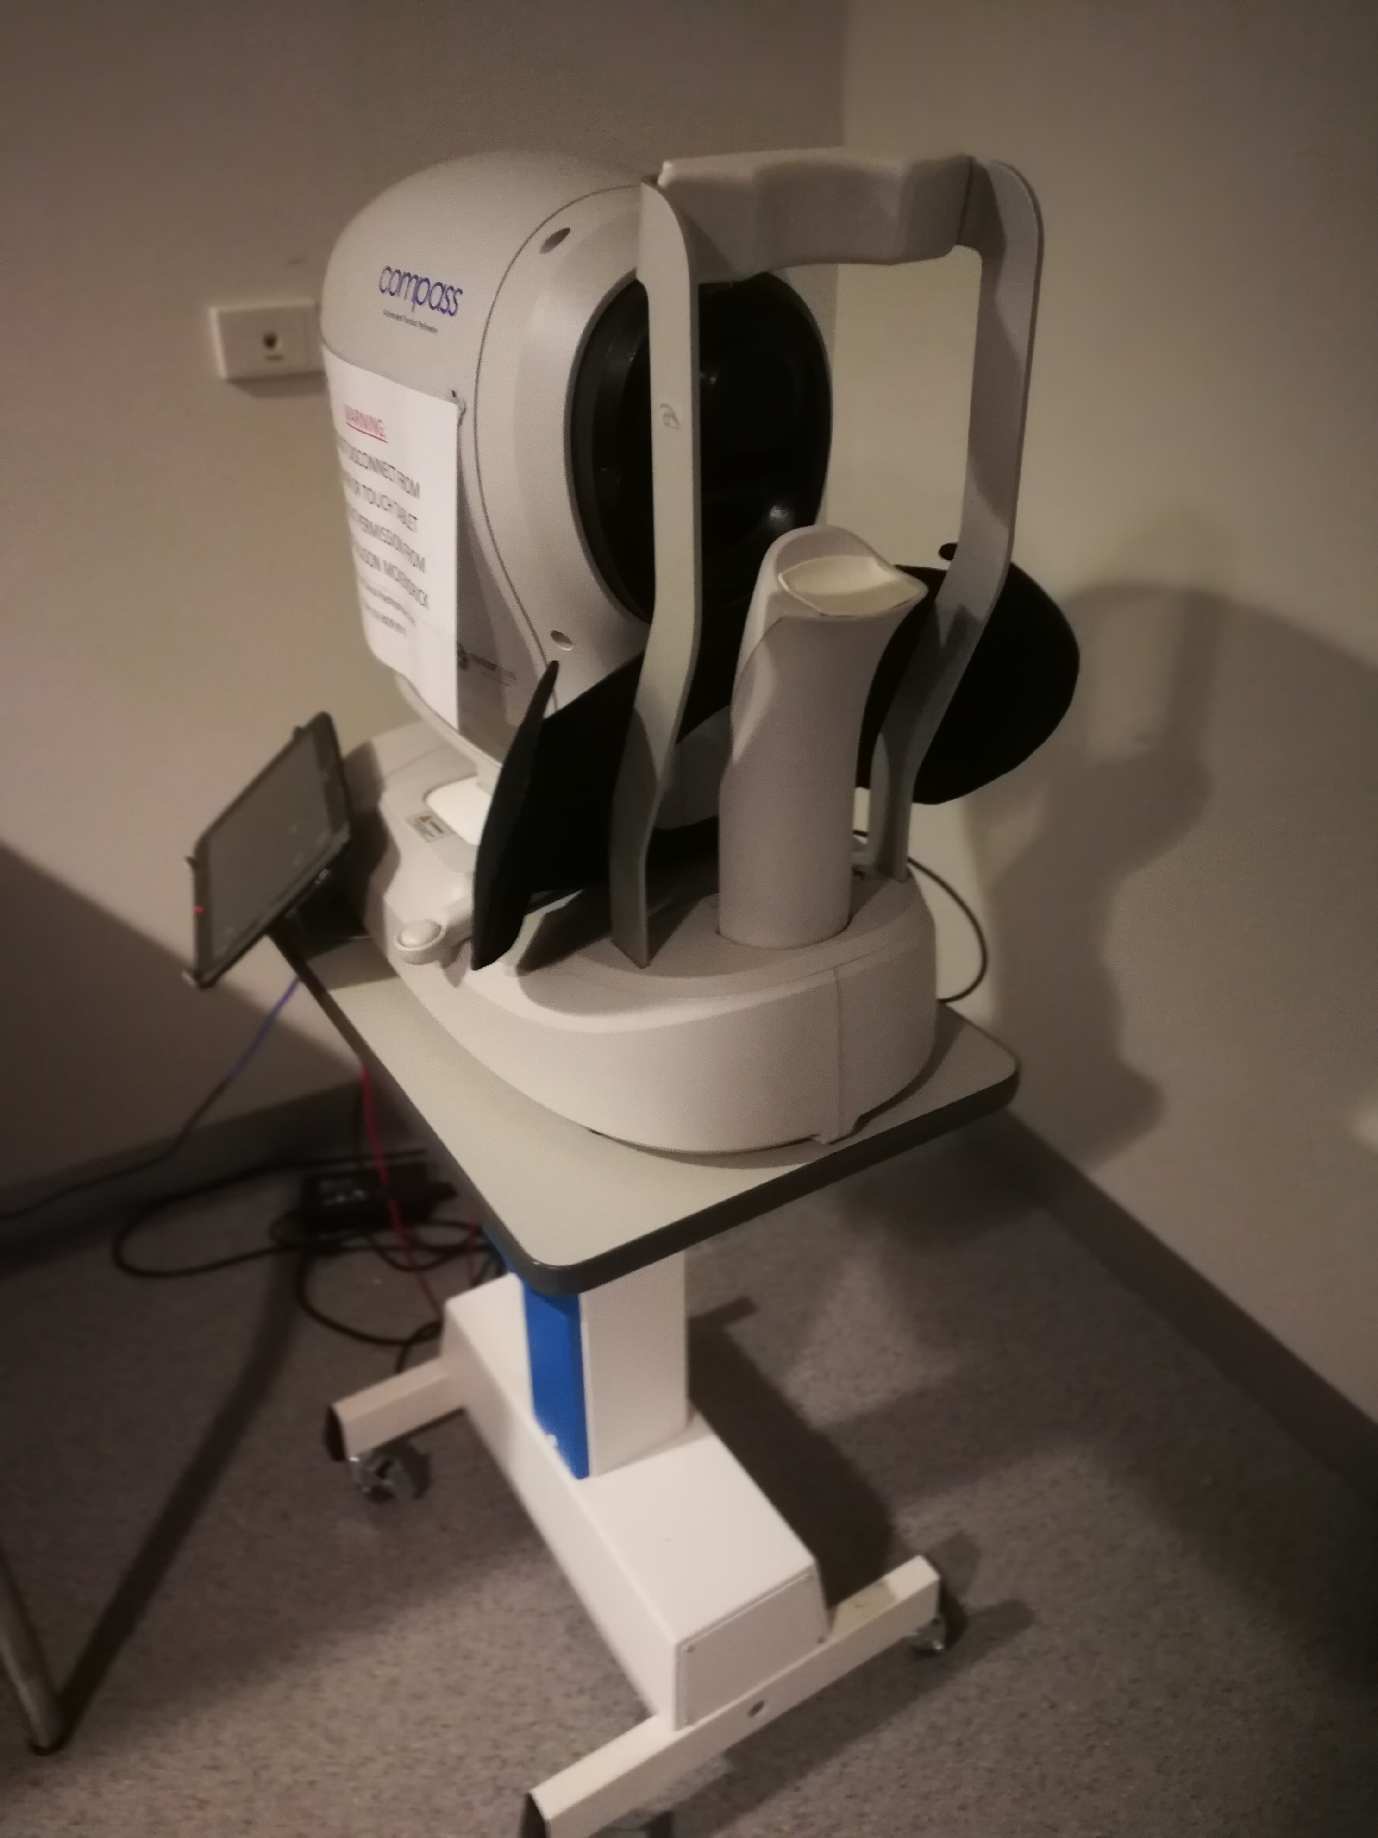
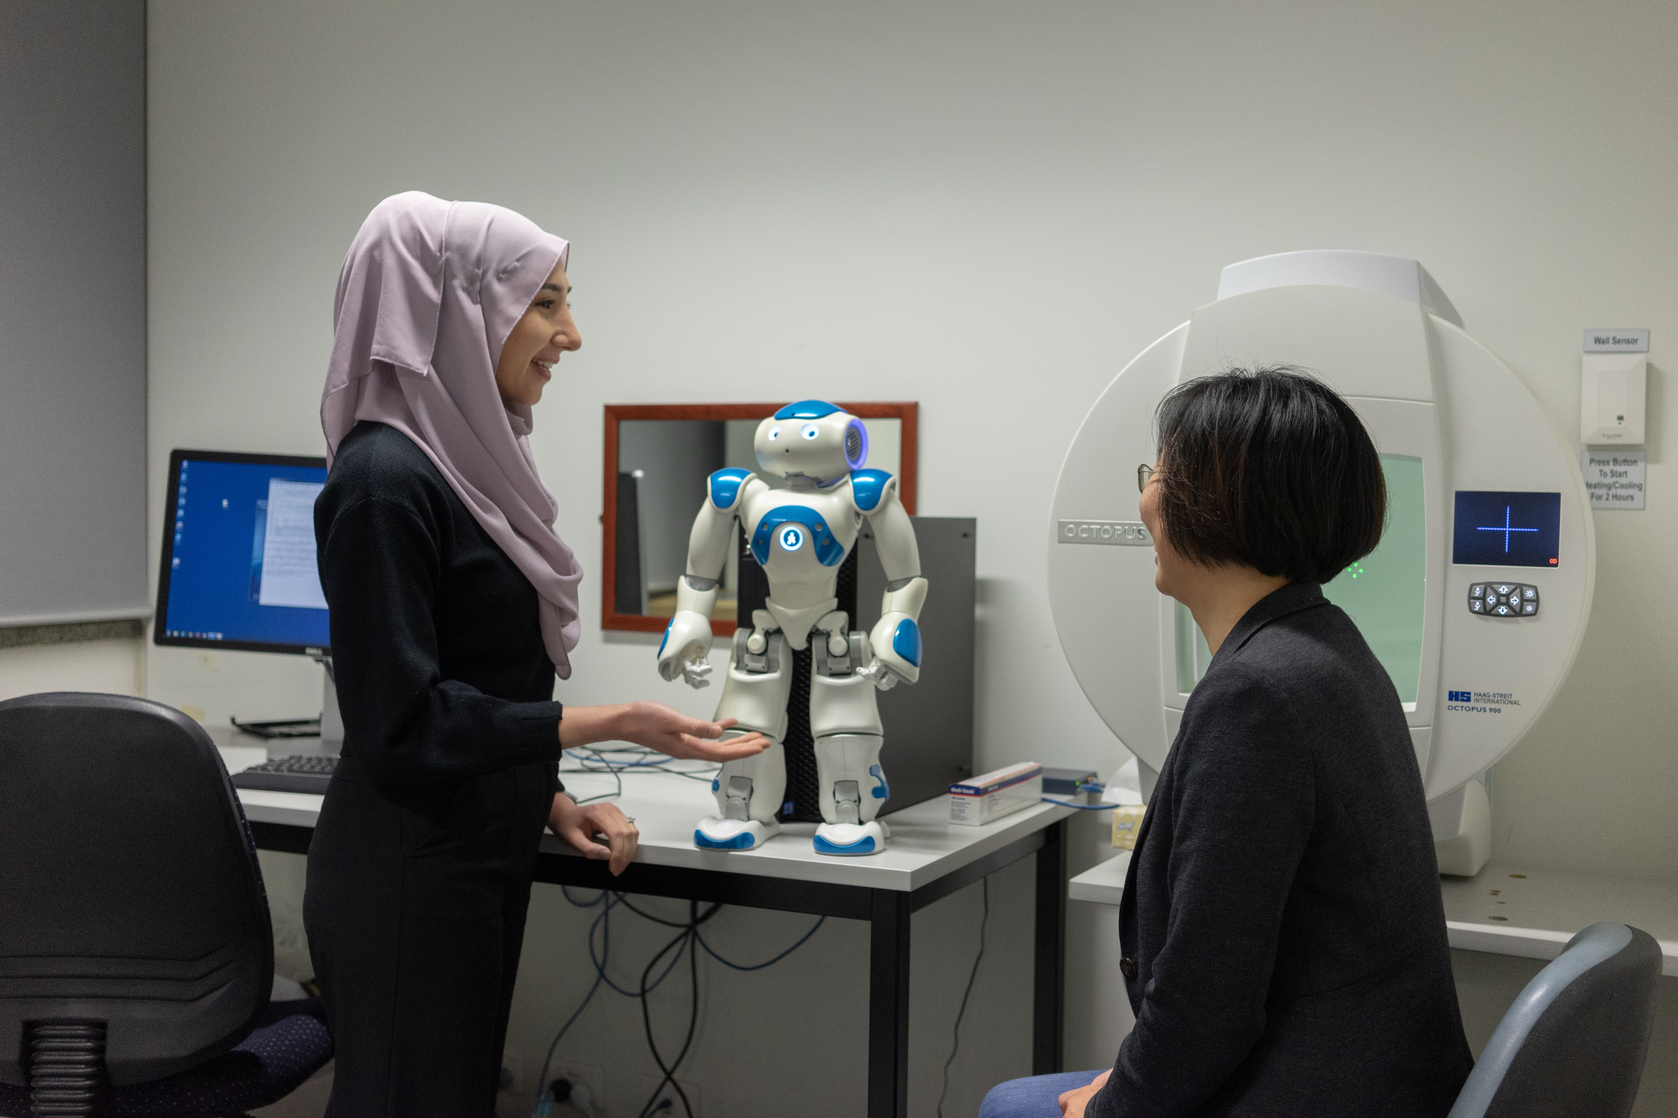
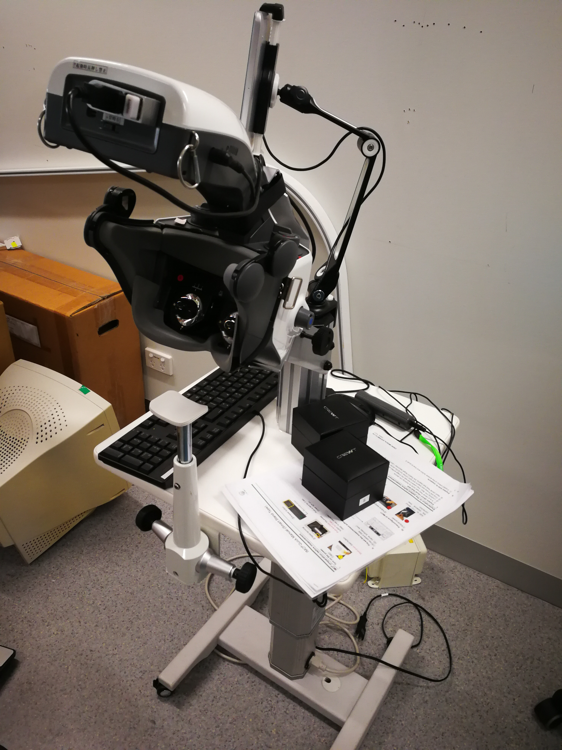
Optometry and vision sciences

Slide 4
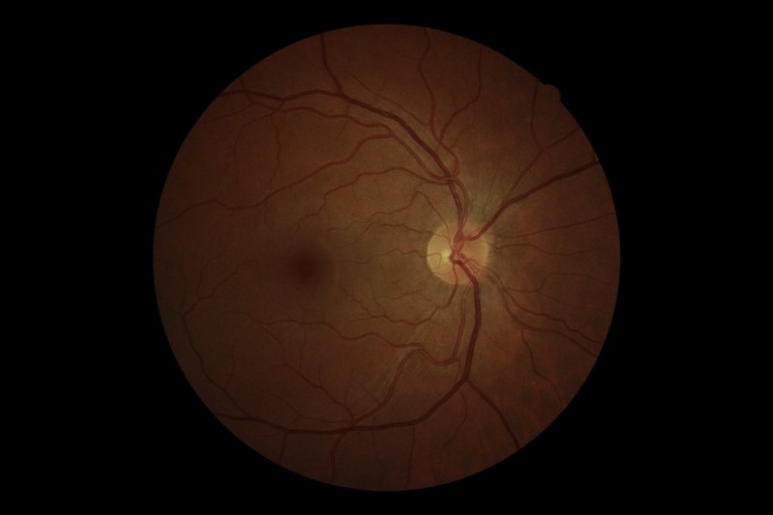
Visual field- Glaucoma
Visual neuron death
No subjective symptoms
VF impairment
Variable progress
No function impairment until binocular VF
impairment occurs

Slide 5
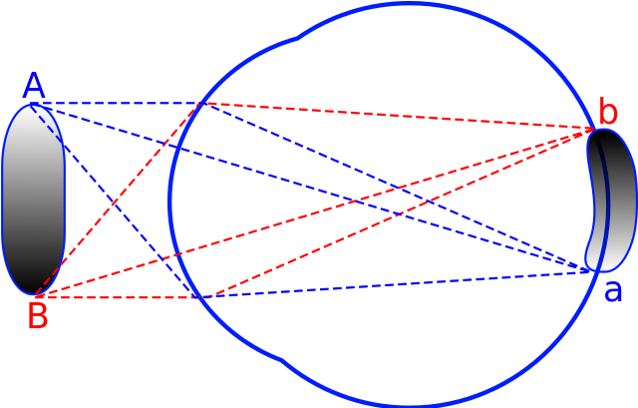
Visual field

Slide 6
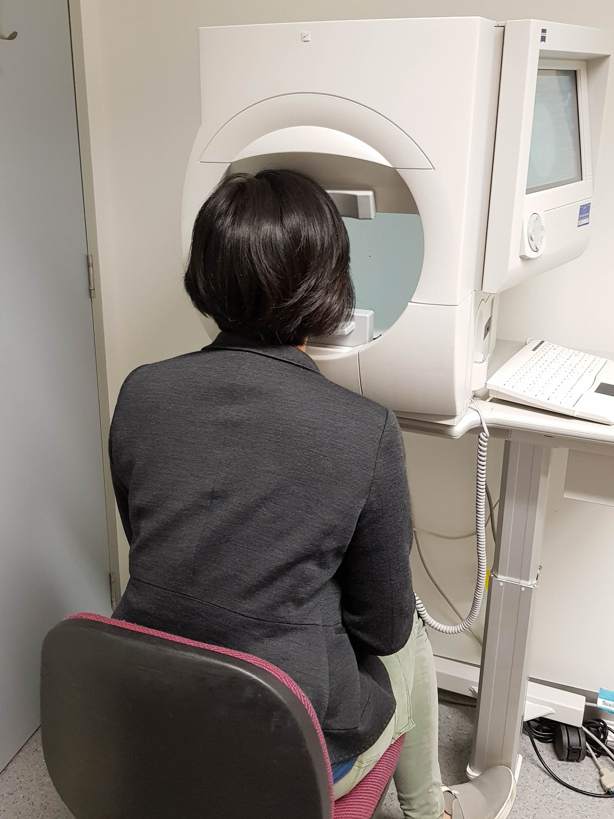
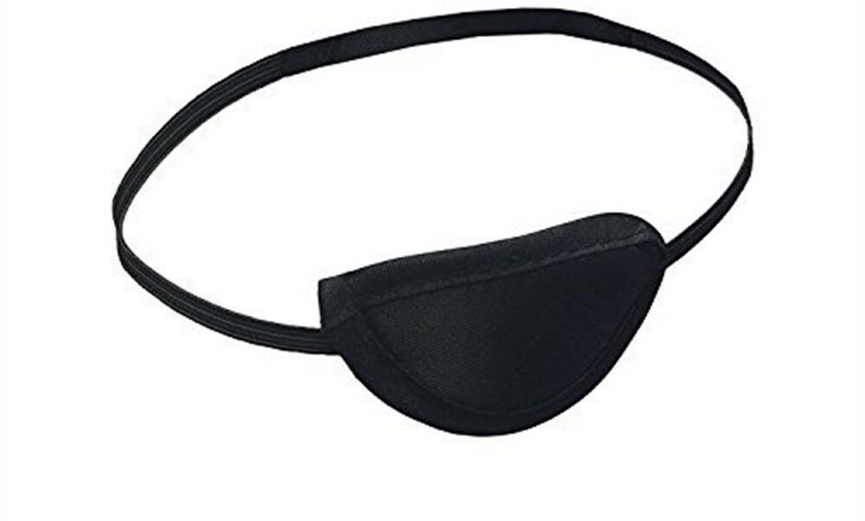
Monocular
Monocular: viewing with one eye
Binocular: viewing two eyes together

Slide 7
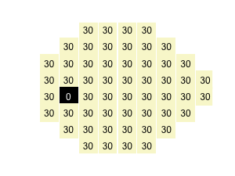
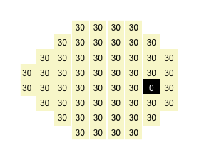
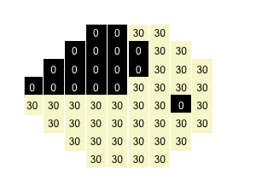
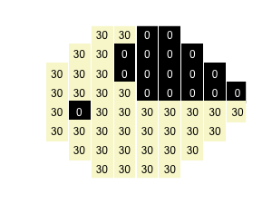
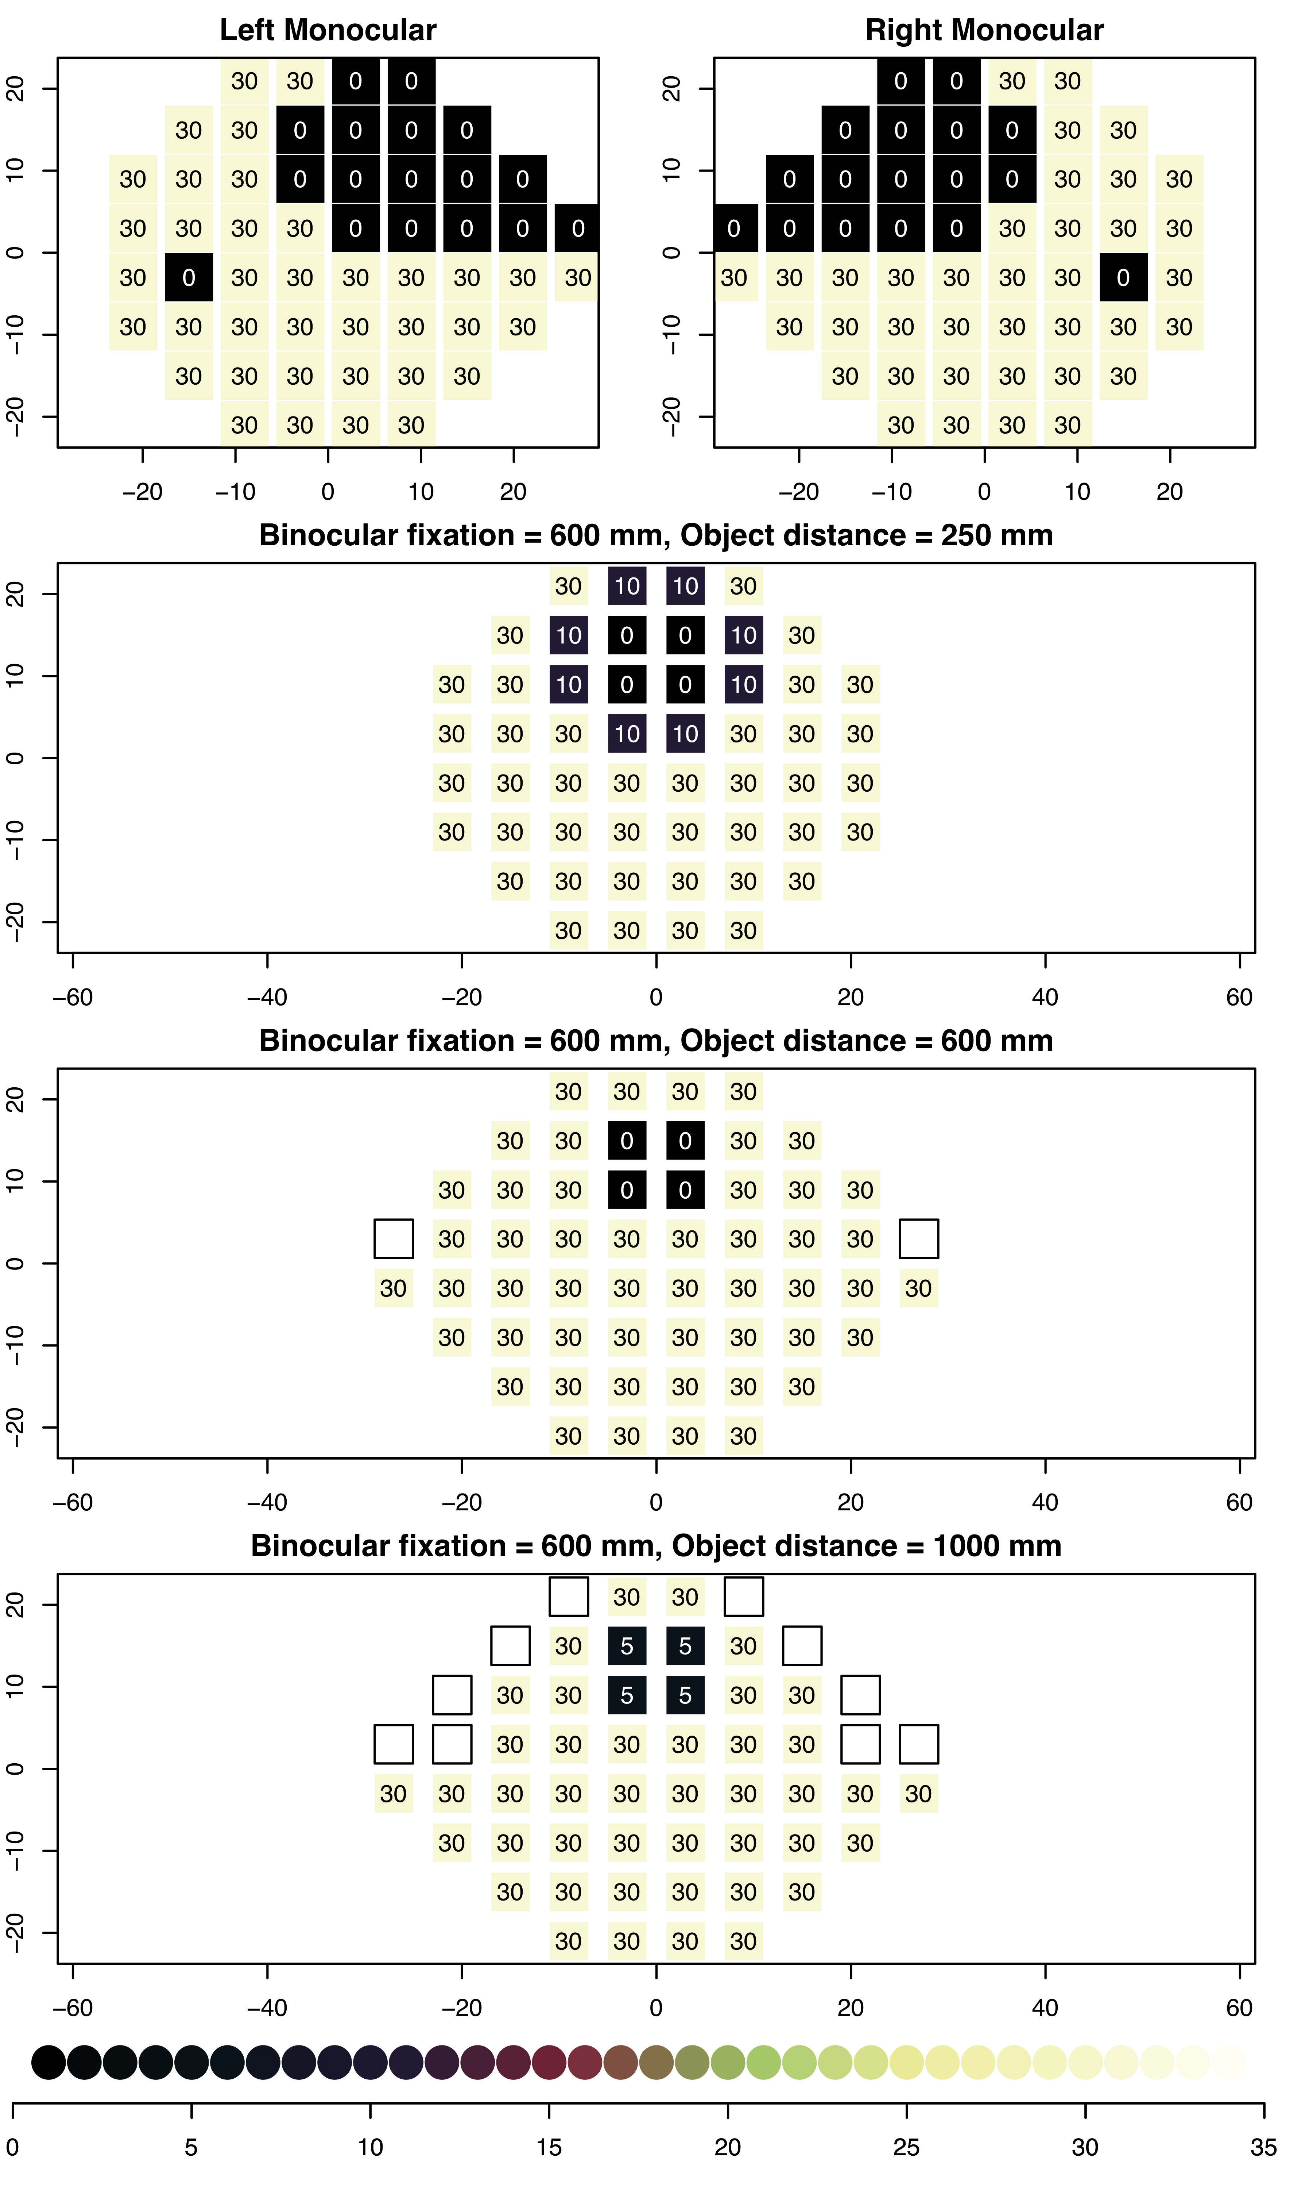
Monocular VF examples

Slide 8
Monocular VF

Slide 9
Binocular VF: Convergence angle

Slide 10
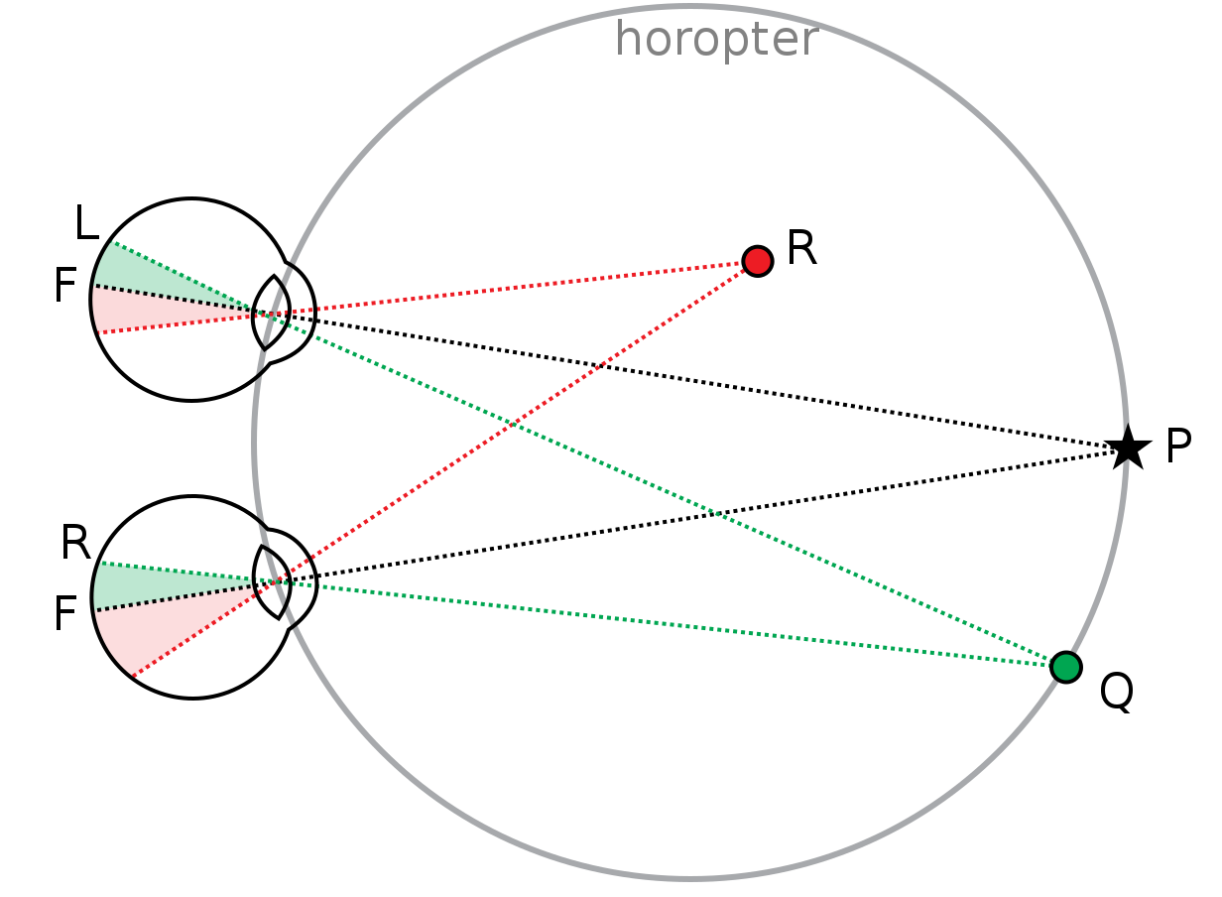
Depth Dependent Binocular VF

Slide 11
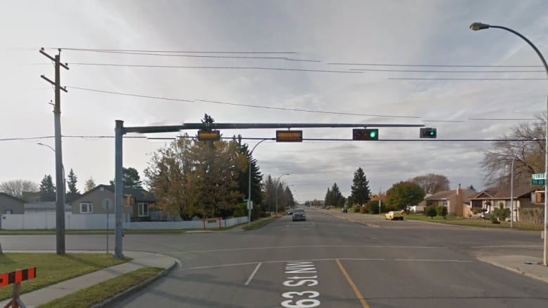
Depth Dependent Binocular VF

Slide 12
Depth Dependent Binocular VF from monocular ones

Slide 13
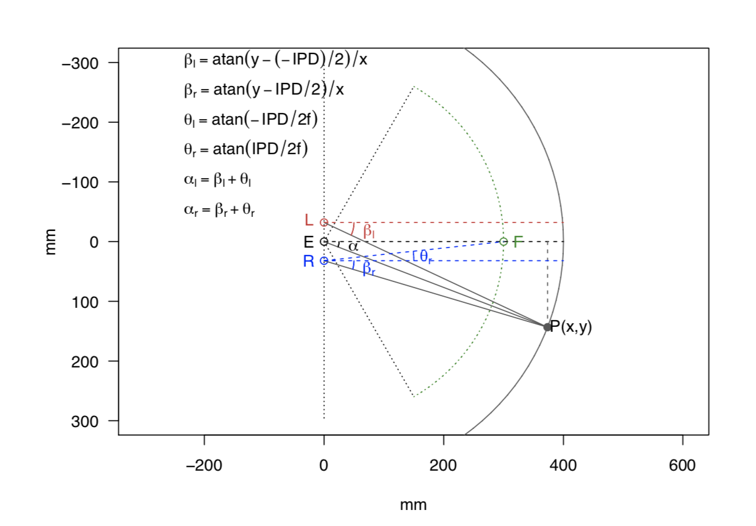
Trigonometry

Slide 15
http://128.250.106.25:3838/binovisualfields/
https://people.eng.unimelb.edu.au/aturpin/opi/index.html
Notes:
Emphasize what we started with , how engineering conceptual knowledge into a product, final package
Use template 2 demonstrate the dramatic effects of distance

